Slide 1
STUDENT DETAILS
NAME: SURAPATI MANASWINI
ROLL NO: 22B61A0578
BRANCH: CSE
COLLEGE: SATYA INSTITUTE OF MANAGEMENT AND TECHNOLOGY

Slide 2
PROJECT TITLE :
Text steganography using capitalization method
Problem statement:
Develop a Python program that implements text steganography using the capitalization method to hide a secret message within a cover text. The program should provide functionality to both encode a message into the cover text and decode the hidden message from the encoded text.

Slide 3
AGENDA:
Introduction
Project overview
End users of the project
Solutions and value propositions
Customization and personalization
Modelling
Results
Links

Slide 4
INTRODUCTION
Definition of steganography:
Steganography is the practice of concealing messages or information within other non-secret text or data.
Applications of steganography in modern technology:
Digital watermarking
Data hiding in communication
Digital forensics
Covert communication
Secure storage
Military and intelligence
Authentication and integrity checking

Slide 5
PROJECT OVERVIEW
Objective:
To develop a system for hiding and retrieving secret messages within text documents, ensuring secure communication without drawing attention to the presence of the hidden information.
Purpose:
The purpose of text steganography is to securely conceal the existence of secret messages within innocent-looking text documents.

Slide 6
WHO ARE THE END USERS OF THIS PROJECT?
Government Agencies and Military
Corporate Enterprises
Digital Forensics and Law Enforcement
Content Creators and Publishers
Researchers and Academics

Slide 7
YOUR SOLUTION AND IT’S VALUE PROPOSITION
Solution:
Text steganography provides a covert and secure means to embed secret messages within innocent-looking text documents. It serves various purposes such as secure communication, data protection, digital rights management, and anonymity.
Value proposition:
Security
Covert communication
Versatility

Slide 8
HOW DID YOU CUSTOMIZE THE PROJECT AND MAKE IT YOUR OWN
Customization:
Implemented user-friendly software to facilitate the process.
Tested the solution with a diverse set of textual formats and document sizes.

Slide 9
MODELLING
Technique used:-
Letter Case Manipulation:
Changing the capitalization of letters within words to encode binary or symbolic data. For example, alternating between uppercase and lowercase letters to represent binary digits.
Tools and software:
Python Programming Language
Standard Library Functions- ord() function, String formatting (format() method)
Development Environment- spyder

Slide 10
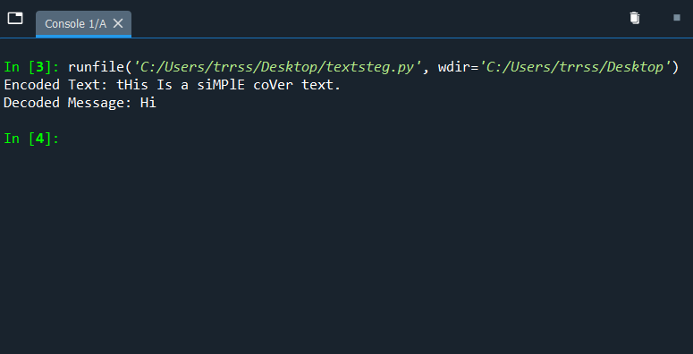
RESULTS

Slide 11
PROJECT LINK
https://github.com/Manaswinigithub/hiding-text-using-steganography

Slide 12
THANK YOU
SURAPATI MANASWINI

